Slide 1
Computing
The “Computing Curricula Overview” (on AUTonline) is an excellent overview. Five discipline areas: computer science, information systems, software engineering, computer engineering, information technology. These boundaries are fluid.
Table 3.1 Strength of stress on topic areas across the 5 disciplines.
Table 3.3 Performance capability of the graduate across the 5 disciplines.
Reference disciplines: engineering, mathematics, cognitive science, psychology, organisational and management sciences...
Top journals: IEEE Transactions, MISQ, ISR, CACM…

Slide 2
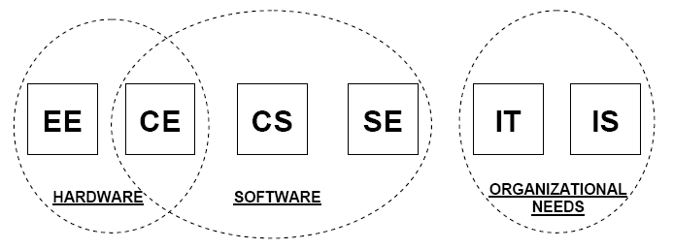
Computing - 2

Slide 3
Research: One Metaview
Discovery and Creation
Discovery
Natural sciences
  How does photosynthesis work?
  Is there life on other planets?
Behavioural studies
  What attitudes do people have to using computers?
  Is the computer system meeting organisational requirements?

Slide 4
Research: One Metaview (2)
Creation
A faster search algorithm
A ubiquitous device
An effective eHealth system
A tool to predict the value of bitmoney

Slide 5
Some Research Terminology
Ontology
  What is Reality? Related to beliefs and religion.
Epistemology/Paradigm/Theoretical perspective
  Theory of knowledge. How can we ‘know’ anything?
Methodology
  Plan of action shaping choice of research methods and linked to research outcomes: how we are going to approach this problem. (eg, Controlled Experiments, Action Research, Symbolic Interactionism…)
Methods
  Techniques and procedures used to gather and analyse data. There are thousands (survey, observation, interview, focus group, case study…)

Slide 6
Epistemology, paradigm, theoretical perspective
Logical/positivist/reductionist
Reality exists independent of the operation of consciousness
Interpretive/constructionist
Truth or meaning comes out of engagement.
Meaning is not discovered, it is constructed.
Critical
Concerned with the possession, use and control of knowledge
Postmodern
Argues that reason cannot discover knowledge.
Concerned with identity and meaning making.

Slide 7
Design Science
See Hevner et al. (2004). Design Science in Information Systems Research. MISQ, 28(1), pp. 75-105.
Outlines how the different stages in the life an artefact - conceptualisation, design, development, use – can be researched.
Read and study the seven guidelines given for the three example studies.

Slide 8
Design Science Guidelines
Guideline 1: Design as an Artifact
Must produce a viable artifact in the form of a construct, a model, a method, or an instantiation.
Guideline 2: Problem Relevance
Develop technology-based solutions to important and relevant business problems.
Guideline 3: Design Evaluation
The utility, quality, and efficacy of a design artifact must be rigorously demonstrated via well-executed evaluation methods.
Guideline 4: Research Contributions
Clear and verifiable contributions in the areas of the design artifact, design foundations, and/or design methodologies.
Guideline 5: Research Rigor
Application of rigorous methods in both the construction & evaluation of the design artifact.
Guideline 6: Design as a Search Process
The search for an effective artifact requires utilizing available means to reach desired ends while satisfying laws in the problem environment.
Guideline 7: Communication of Research
Design-science research must be presented effectively both to technology-oriented as well as management-oriented audiences.

Slide 9
Design Evaluation Methods
Observational
Case Study: Study artifact in depth in business environment
Field Study: Monitor use of artifact in multiple projects
Analytical
Static Analysis: Examine structure of artifact for static qualities (e.g., complexity)
Architecture Analysis: Study fit of artifact into technical IS architecture
Optimization: Demonstrate inherent optimal properties of artifact or provide optimality bounds on artifact behavior
Dynamic Analysis: Study artifact in use for dynamic qualities (e.g., performance)
Experimental
Controlled Experiment: Study artifact in controlled environment for qualities
Simulation: Execute artifact with artificial data
Testing
Functional (Black Box) Testing: Execute artifact interfaces to discover failures and identify defects
Structural (White Box) Testing: Perform coverage testing of some metric (e.g., execution paths) in the artifact implementation
Descriptive
Informed Argument: Use information from the knowledge base (e.g., relevant research) to build a convincing argument for the artifact’s utility
Scenarios: Construct detailed scenarios around the artifact to demonstrate its utility

Slide 10
Abstractions
Are these usability evaluation methods typically done to the conditions of the actual use of the artefact?
 | Questionnaire | Interviewing | Expert Walkthrough | Usability Testing
Time | No | No | No | Y/N
Place | No | No | No | Y/N
Artifact (as primary focus) | No | No | Yes | Yes
User | Yes | Yes | No | Yes
User’s cognitive framework | No | Y/N | No | Yes

Slide 11
Formulating a research question
Choose a topic area that is interesting, relevant and useful.
There are many ways to refine that down into a research question.
The document “Post Graduate Research: Getting Started” gives some guidelines many people find useful.

Slide 12
Formulating a research question
Let’s say you want to compare the Mac interface with the Windows interface.
You could scope it down by studying just one feature, or a set of tasks, or user type, or all three.
The choice of these will be constrained by what you have access to.
Given the multi-cultural make-up of the students in our class, a cross cultural study is doable.

Slide 13
Formulating a research question
Another approach is to state your point of view or what you hope for.
Let’s say you are interested in the creation of informal, bottom-up organisations and you have enjoyed using Facebook.
Facebook can help an individual turn their intentions into social action. Or:
How can Facebook assist an individual turn their intentions into social action?

Slide 14
The inquiry
There are thousands of methods that can be used.
For this project, you are most likely to use a quantifiable measurement, a questionnaire, interviews, or a case study.
Whatever method, you must do some kind of pilot test for the proposal. This pilot test will assist many of you to get a better handle on both the research question and the method you will use.

